Slide 1

Event Registration Form: HTML, CSS, and JavaScript
This project explores the development of a responsive and user-friendly event registration form using HTML, CSS, and JavaScript. The form streamlines the sign-up process, providing a seamless experience for event organizers and attendees.
By - Bhoomika Arya

Slide 2

Objective and Goals
1
Streamlined Sign-up
2
Responsive Design
Develop a clean, intuitive event registration form that simplifies the sign-up process.
Ensure the form is mobile-friendly and adapts to various screen sizes.
3
Dynamic Validation
Implement real-time form validation to enhance user experience and data accuracy.

Slide 3
Key Features
Registration Fields
Dynamic Validation
Event Selections
Comprehensive set of fields for attendee information, including name, email, and event selection.
Instant validation of form inputs, providing clear feedback to users for a seamless experience.
Ability to choose from multiple event options, with clear display of available slots

Slide 4
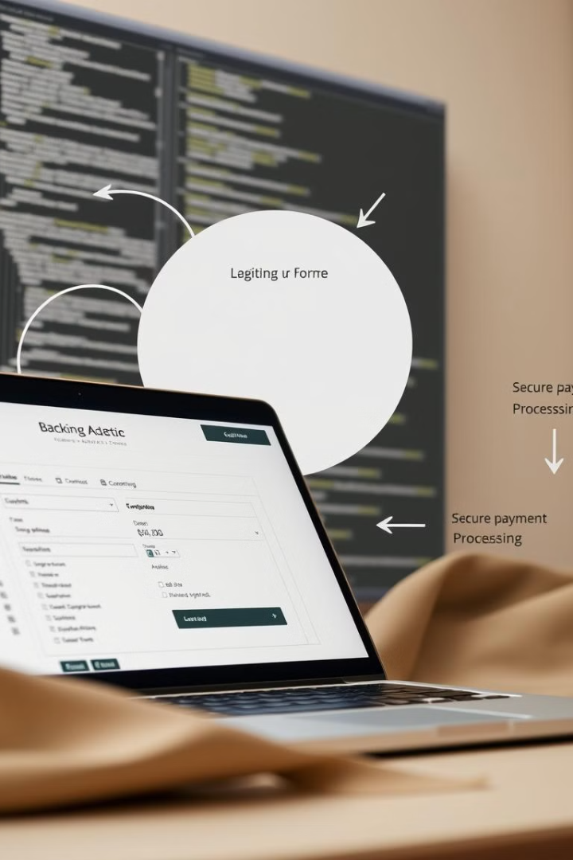
Project Details
1
Front-end Development
Leverage HTML, CSS, and JavaScript to create an engaging and responsive user interface.
2
Deployment and Testing
Deploy the application on a secure hosting platform and thoroughly test for optimal performance.

Slide 5

Hardware and Software requirements
Hardware
Software
Modern computer with a stable internet connection and sufficient processing power.
Code editor (e.g., Visual Studio Code), web browser, and a server environment (e.g., Node.js, Apache).

Slide 6
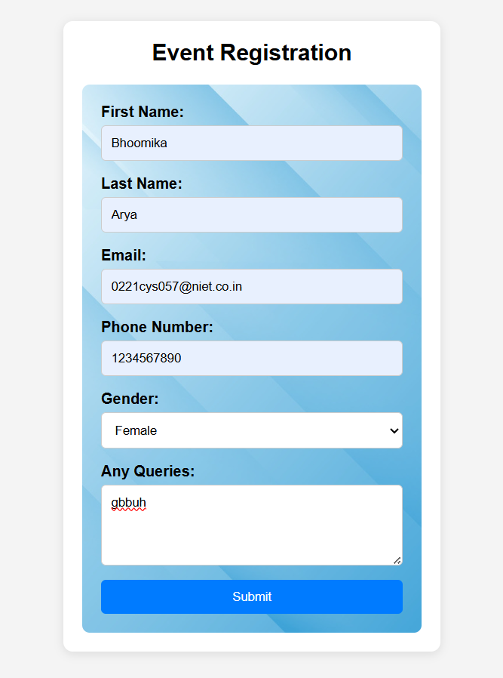
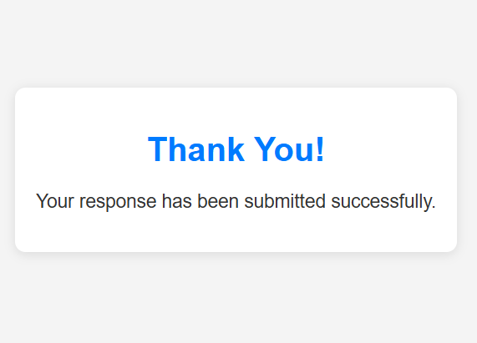

Slide 7
Data Flow Diagram
[ User Inputs ]
|
v
[ Form Submission ]
|
v
[ Validation Process ]
| |
| |
v |
[ Valid ] |
| |
v |
[ Store Data (optional) ]
|
v
[ Redirect to Thank You Page ]

Slide 8




Skills Acquired
HTML Mastery
Proficiency in structuring the event registration form using HTML.
CSS Styling
Ability to design and implement responsive, visually appealing form styles.
JavaScript Expertise
Adept at adding dynamic functionality, form validation, and event handling.

Slide 9

Challenges faced
Cross-Browser Compatibility
Security Considerations
Ensuring the form works seamlessly across different web browsers and devices.
Implementing robust security measures to protect user data and payment information.
Performance Optimization
Optimizing the form's load times and responsiveness for a smooth user experience.

Slide 10

Career growth
1
Skill Development
Expanding expertise in front-end and back-end web development techniques.
2
Portfolio Enhancement
Adding the event registration form project to your portfolio to showcase your capabilities.
3
Career Opportunities
Demonstrate your versatility and problem-solving skills to potential employers.

Slide 11
Conclusion
The development of a robust and user friendly event registration form is essential for a successful event. This project ensures a well-structured, visually appealing, and functional form, providing a positive user experience for event registrants.
User-Friendly Design
Responsive Layout
The form is designed with the
user in mind, offering
intuitive navigation and clear
instructions.
The form adapts to different screen
sizes, ensuring optimal viewing
on all devices.

Slide 12


